Slide 1
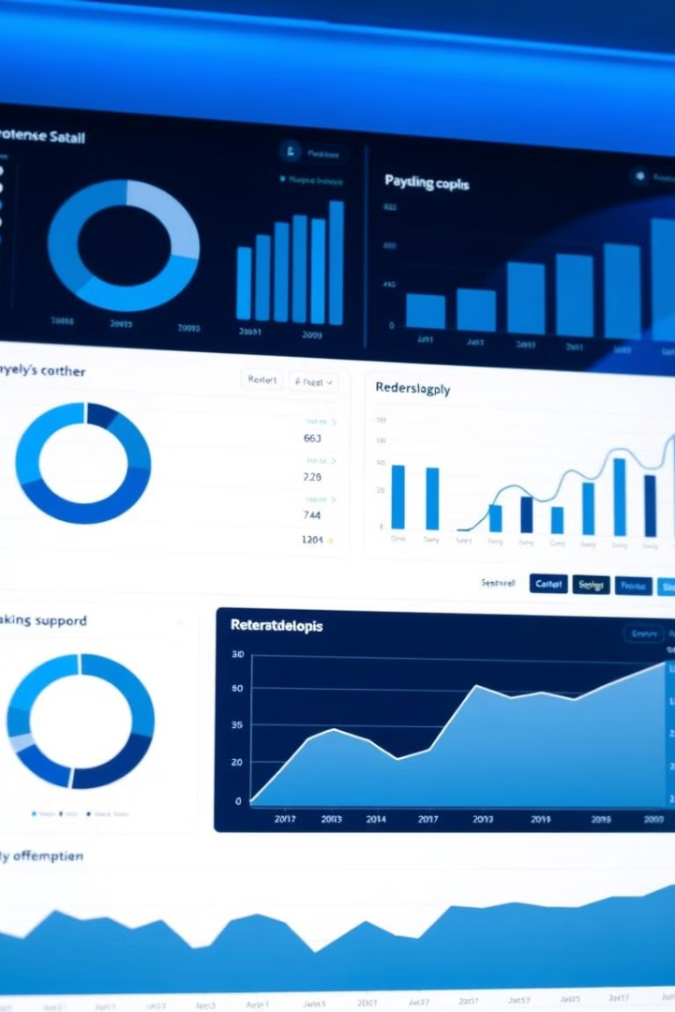

AI-Assisted Stock Trend Analyzer (InvestIQ)
We want to assist investors in making informed decisions by analyzing financial data from the INC 5000 companies dataset to identify trends, generate actionable insights, and uncover potential investment opportunities.
To address this problem, our project aim to develop an AI-Assisted Stock Trend Analyzer that uses historical market data and ML models to generate actionable insights and identify potential investment opportunities.

Slide 2
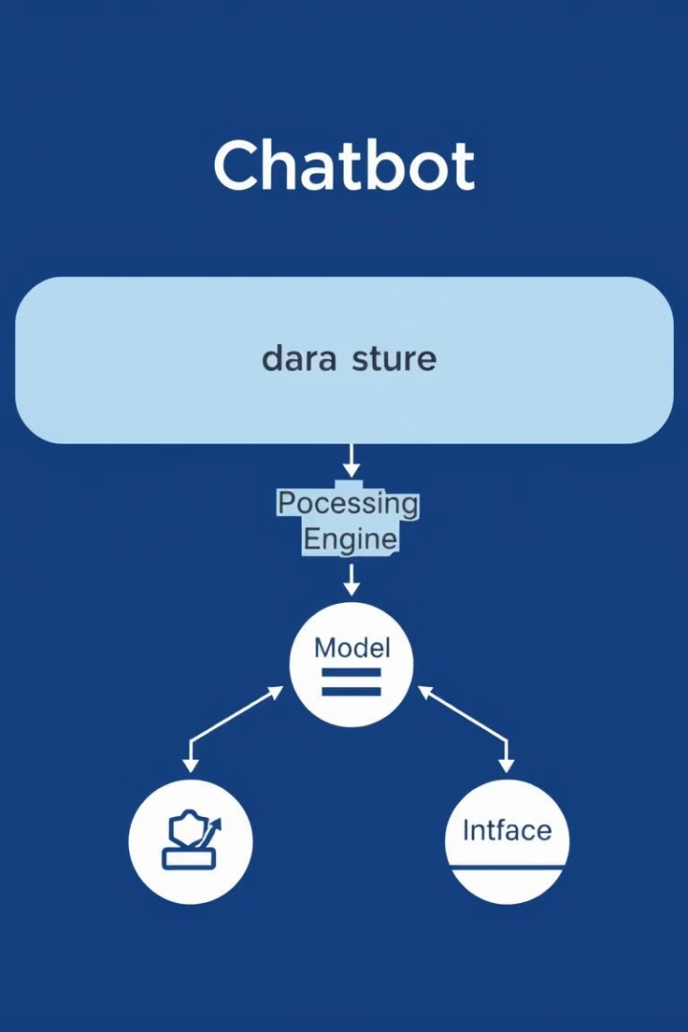
Chatbot Architecture : key components
1
Database
2
Language Model
Storage and questioning of financial data
We’ve used the INC 5000 companies dataset.
Generation of insights and answers to questions.
We’ve used two languages models (gpt2 and gpt-35-turbo)
3
Backend
4
Frontend
Processing of requests and data management.
User interface for investors (React).

Slide 3

Use of a database
Storage
Questioning
The financial data of the INC 5000 is stored in a relational database to ensure the integrity and consistency of the data.
The database makes it possible to search and question the data effectively and flexible.

Slide 4



Exploitation of a language model
The approach used
Generation of insights
Finetune the AI model with sentiment dataset.
The user prompts the model with a natural language test.
The AI model converts the user prompt to a SQL query.
The AI model should use the SQL query to extract data from the stock_db (the INC 5000).
Use the AI model to generate user-friendly outputs related to the user prompt.
The model generates usable information for investors, depending on their needs and objectives.
We’ve finetuned the model gpt2 with our sentiment data to generate user-friendly outputs.
And gpt-35-turbo for generating SQL queries.

Slide 5

The backend : Treatment of requests and integration
1
Treatment of user requests.
2
Extraction of relevant data from the database.
3
Integration of the language model for the analysis and generation of insights.
We initially planned to use Django as the backend framework to establish integration between the frontend and backend components of the application. However, due to time constraints, we were unable to implements this aspect of the project as intended.
4

Slide 6

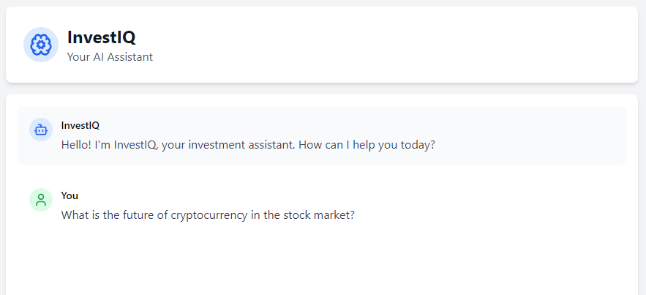



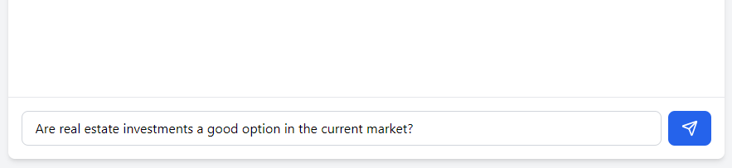
The frontend : intuitive user interface
Friendly and intuitive user interface for investors (using the framework React).
Possibility of asking questions in natural language.
Display of insights and relevant data.

Slide 7

Conclusion : advantages for investors
1
2
3
Relevant Insights
Increased Efficiency
Best Returns
Obtain usable information to make informed decisions.
Quickly access relevant data and insights.
Maximize investment returns using accurate information.

